Slide 1
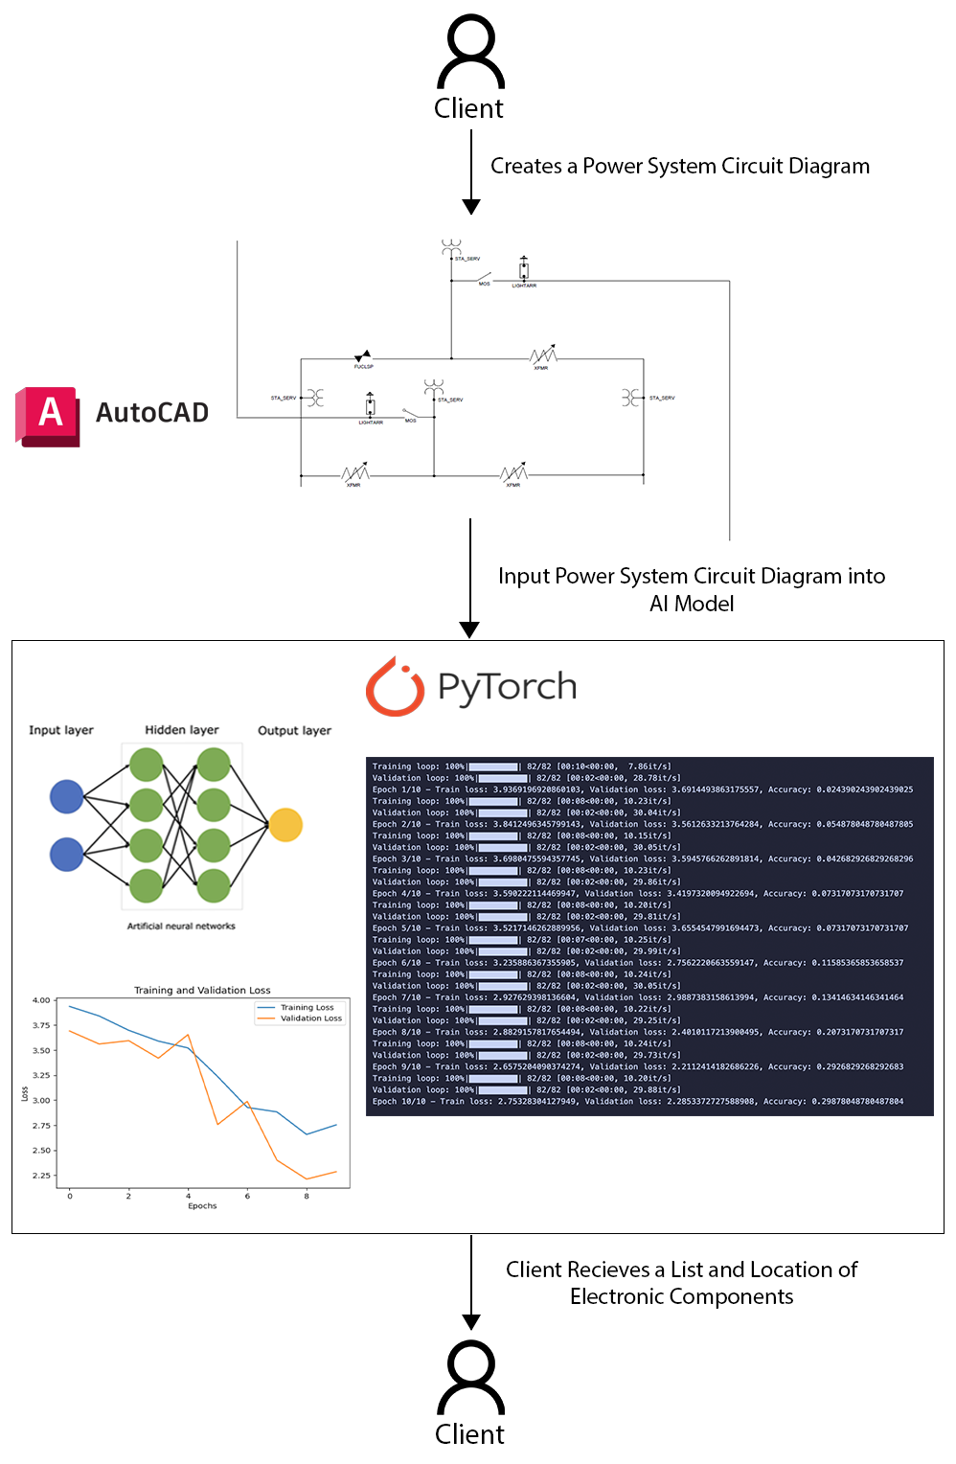
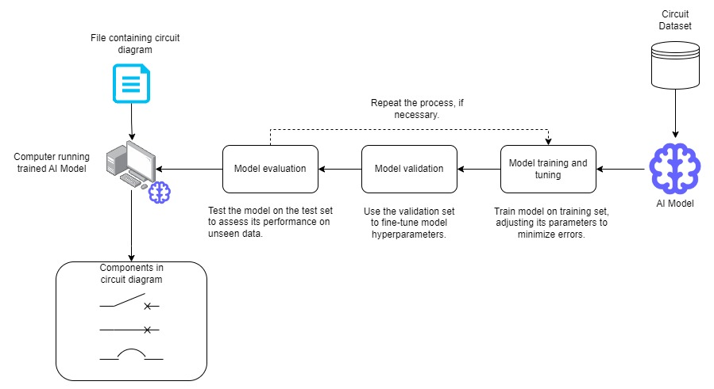
25-338
Intelligently Identifying and Locating Electronic Components in Power System Circuit Diagrams
Team members: Kyle Jones, Daniel Polen, Alex Kem, Erick Zheng | Faculty adviser: Changqing Luo | Sponsor: Changqing Luo | Mentor: Changqing Luo
Problem Statement
Given the large volume of diagrams handled by power companies, manual analysis is often inefficient and error-prone. By leveraging artificial intelligence and image processing techniques, this project seeks to detect various components and accurately determine their positions within these diagrams. This approach will enhance efficiency in power system design, planning, analysis, and troubleshooting.
Objectives
Define key electronic components to be designed and collected into a dataset for training
Process data into multiple formats suited to test and train the model on more images
Design a machine learning model using PyTorch for image-based recognition
Train the model on annotated diagrams while adjusting parameters to achieve desired accuracy
Expand the ML model to be able to handle further information gathering from the diagrams regarding location of each component
Develop more complex system diagrams using AutoCAD to be added to the dataset for further testing and training
Conduct final testing after training on the new images to achieve the required level of performance and reliability
High Level Design
UML

